Slide 1
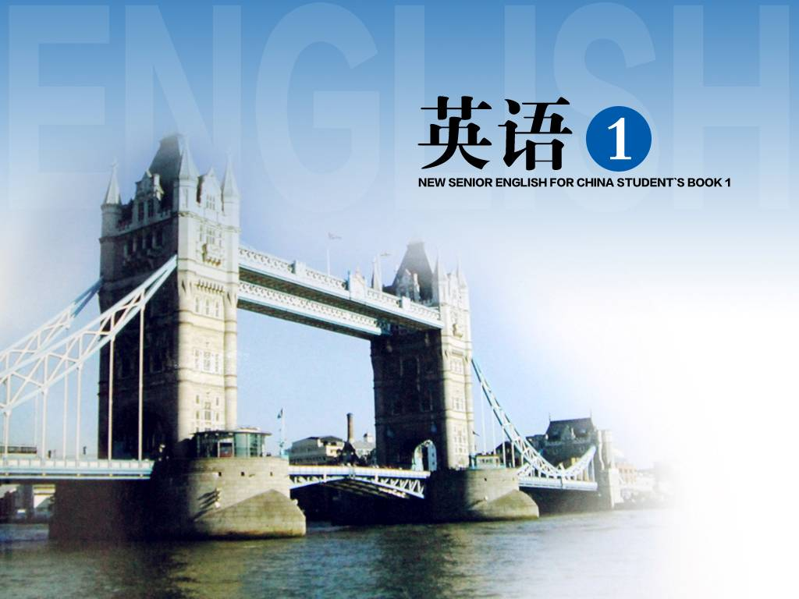
Unit 4

Slide 2
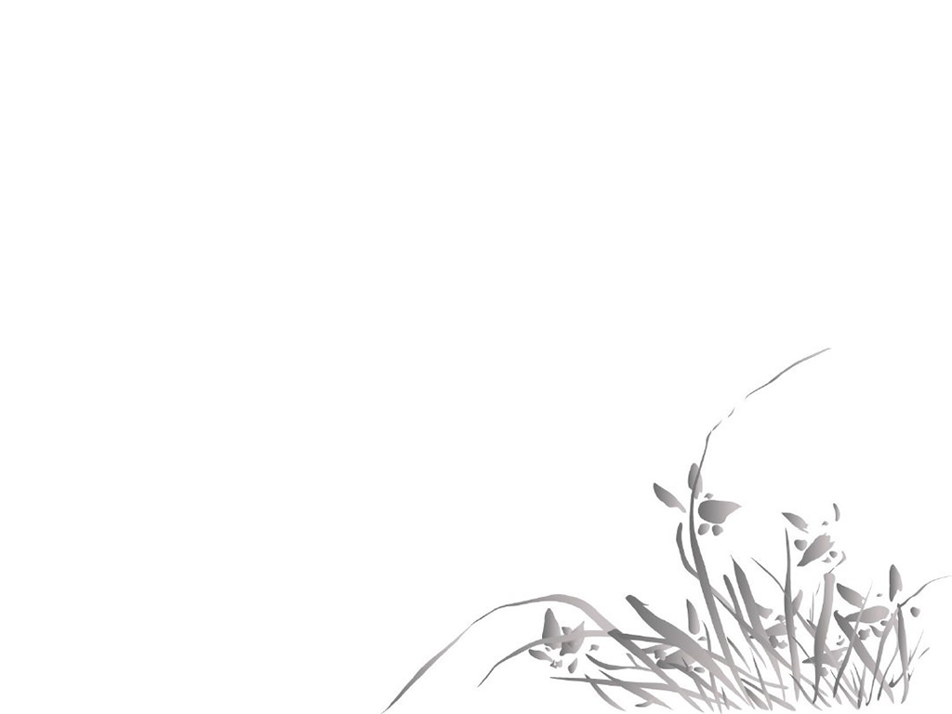
Unit 4 Earthquakes

Slide 3


Slide 4

1. Imagine your home begins to shake and you must leave it right away.
假如你家发生地震你必须马上离开。
right away: at once; in no time; immediately
right now: at this very moment
e.g. Make up your mind ___________.
I’ll return the book ___________.
right now
right away

Slide 5
2. In the city, the water pipes in some buildings cracked and burst.
在市内, 有些建筑物里的水管爆裂开来。
阅读下列句子, 并试着总结burst在句中的词性、含义及用法。
1) The pipes had burst and the house was under two feet of water.
2) The police burst into the room and
took the young man away.

Slide 6
3) Hearing the news, the woman burst into laughter.
4) She burst out crying for no reason,
which surprised us.
5) There was a burst of laughter in the
next room.

Slide 7
【归纳】
burst作___词, 意思是_____(句1); 常用于短语burst into + a room, building, etc. 闯入, 突然破门而入(句2); burst into + n. 突然爆发, 突然……起来(句3); burst out doing 突然……(句4)。burst作___词, 意思是_________(句5), 还可指“爆裂; 破裂之处, 裂口”。
动
爆裂
名
突然一阵

Slide 8
用burst或其短语的适当形式填空。
1) The plane crashed and _________ flames.
2) The dam _____ because of the heavy rain.
3) It looked as if Kate was about to ______ _____ tears.
4) Everyone was quiet when John suddenly
_________ laughing.
burst into
burst
burst
into
burst out

Slide 9
But the one million people of the city, who thought little of these events, were asleep as usual that night.
【分析】这是一个主从复合句。句子的
主干是____________________________
_______________________。_____引导
非限制性定语从句, 修饰people。
think little of 意为“轻视, 不重视”。
But the one million people were asleep as usual that night
who

Slide 10
【句意】
但是, 唐山市的一百万居民几乎都没有把这些情况当作一回事, 当天晚上照常睡着了。
【仿写】
这些孩子们几乎都没有把他的话当回事,
照常在河里游泳。
___________________________________
___________________________________
The children, who thought little of his words, swam in the river as usual.

Slide 11
3. It seemed as if the world was at an end!
世界似乎到了末日！
1) as if 似乎, 好像 = as though
e.g. She spoke to me as if she knew me.
2) as if 引导表语从句，表示“看起来好像”
e.g. It seemed as if the meeting would
never end.

Slide 12
本文中as if 的用法就是第二种。
It seemed as if the world was at an end!
= It seemed that the world was at an end!

Slide 13
翻译句子。
1) 我的姐姐有时候对待我就好像我是陌生人似的。
2) 那个男孩已经学习很长时间了，他现在看起来好像已经很累了。
Sometimes my sister treats me as if I were a stranger.
The boy has been studying for quite a long time. It seems as if he is very tired now.

Slide 14

at an end = “finished”
at the end of/by the end of/in the end
at the end of 用于表示具体事物或场所的场合, 它也可以用来表示比喻意;
by the end of 用于表示时间的场合, 到……结束的时候, 用于完成时态;
in the end 意思“最后、终于”。

Slide 15
完成句子。
1) His father will return home
___________ this year.
2) He will be a scientist __________.
3) How many English words had you
learned ____________ last term?
at the end of
in the end
by the end of

Slide 16
4. In fifteen terrible seconds a large city lay in ruins.
在可怕的15秒钟内, 一座大城市就沉沦
在一片废墟中。
lie (lay, lain): to be, remain or be kept in a certain state
阅读下面句子, 归纳ruin的意思及用法。
1) Numbers of people were buried under
the ruins in the earthquake.
2) A large number of buildings fell into
ruin after the earthquake.

Slide 17
3) Several villages were ruined during the typhoon.
4) This heavy rain ruined our plan to go
on a picnic this afternoon.
5) I have lost all my money in business and am now ruined.

Slide 18
【归纳】
ruin既可作名词, 也可作动词。作名词, 意为: ① _______(句1); ②毁灭或破败状态(句2)。作动词, 意为: 毁坏, 毁灭(句 3、句4); 使破产(句5)。
废墟
【拓展】in ruins 严重受损, 破败不堪
e.g. The houses across the street were in
ruins.

Slide 19

ruin/destroy/damage
destroy, damage, ruin三个词都有“破坏, 毁坏”的意思。
destroy多指彻底地、毁灭性地破坏，含导致无用，不能或很难再修复的意味。e.g. The rainforests are being destroyed
at a frightening rate.

Slide 20
damage多指对无生命物体的损害, 造成降低价值、破坏功能等后果。
e.g. Many buildings were badly damaged
during the war.
ruin多指因外部原因而受到严重破坏或毁灭, 侧重破坏的彻底性, 也可用于引申意义。
e.g. Her injury ruined her chances of
winning the race.

Slide 21
完成句子。
1) The village ____ in ruins after the war.
2) These machines have ____ idle since the factory closed.
lay
lain
3) An earthquake left the whole town _________.
4) His career is ________.
in ruins
in ruins
5) Everywhere they looked nearly everything was _________.
destroyed
6) He ______ his girl friend’s prospects.
ruined
7) Soft wood ________ easily.
damages

Slide 22
5. Two-thirds of them died or were injured
during the earthquake.
2/3的人在地震中死去或受伤。
e.g. More than 61% of the surface of the
earth ____ covered by water.
Seventy percent of the workers in this
factory ____ young.
以百分数作为主语的, 谓语动词是单数还是负数取决于百分数后面跟的名词是可数还是不可数的。
is
are

Slide 23
请根据提示完成下列句子。
1) _________ (三分之一) of the students in
our class ____ (be) girls.
2) ___________ (五分之三) of the soil
___________ (wash) away by the flood
last night.
3) ______ (一半) of the desks in this school
_________ (make) in his company.
4) ______ (大部分的) of the lecture he made
yesterday ____ (be) interesting.
One-third
are
Three-fifths
was washed
Half
are made
Most
was

Slide 24
Thousands of families were killed and many children were left without parents.
【分析】
这是一个由and连接的并列复合句。
第二个分句的结构为: 主语(many
children) + 谓语(were left) + 主语
补足语(without parents)。

Slide 25
Everywhere they looked nearly everything
was destroyed.
【分析】
① 本句是一个主从复合句。
② 主句是nearly everything was destroyed,
从句是Everywhere they looked。
③ Everywhere在此用作连词, 引导______
状语从句。
地点

Slide 26
【句意】
人们随处看到的一切几乎都被毁了。
【仿写】
我走到哪里, 我女儿就跟到哪里。
____________________________________
My daughter follows me everywhere I go.

Slide 27
6. People were shocked. 人们惊呆了。
shock v. “make someone feel very
surprised”
阅读下面句子, 并试着归纳shock的意思及
用法。
1) They had been shocked to hear / learn
that the hospital was closing down.
2) He was shocked at the news of Jane’s
death.

Slide 28
3) He never recovered from the shock of
his son’s death.
4) The whole thing has come as such a
shock to me.
5) The shock was felt miles away.
6) She was taken to hospital suffering
from shock.

Slide 29
【归纳】
shock既可作动词, 也可作名词。
作动词, 意为“使震惊, 使惊骇”, 常用于以下结构: shock sb. to hear / learn +从句(句1); be shocked ___ sth. (句2)。
作名词, 意为: ① 给人打击的事, 震惊, 令人震惊的事 (句3和句4) (可构成短语come ____ a shock); ② 震动 (句5) ; ③ 休克 (句6)。
at
as

Slide 30
【拓展】
shocked adj. 吃惊的, 震惊的
shocking adj. 令人震惊的, 极坏的
用shock的适当形式填空。
1) The news of his mother’s death was a terrible ________ to him.
2) What ________ us most was that such a good boy should quarrel with his father.
3) O. Henry’s short stories always gave the readers _________ endings.
shock
shocked
shocking

Slide 31
7. Some of the rescue workers and doctors
were trapped under the ruins.
有些医生和救援人员被困在废墟下面。
阅读句子, 归纳trap的意思及用法。
1) Twenty miners were trapped
underground after the accident.
2) I was trapped into telling him all I knew.
3) If we’re lucky, the thief will fall right
into our trap.
4) To break out of the trap they need help
from the government.

Slide 32
【归纳】
trap既可作动词, 也可作名词。
作动词, 意为: 使陷入困境(句1); 使陷入圈 套, 使中计, 使上当(句2) (常构成短语trap sb. _____ doing sth.)。
作名词, 意为: 陷阱(句3); 困境(句4)。
into

Slide 33
根据括号内的汉语提示补全下面句子。
1) I knew perfectly well _____________
(它是一个陷阱).
2) By clever questioning, they
_______________ (诱使他) making an
agreement.
it was a trap
trapped him into

Slide 34
rescue v. “save something or somebody from danger”
阅读句子, 归纳rescue的意思及用法。
1) The lifeboat was sent out to rescue the
students from the sinking ship.
2) The firemen rescued a baby from the
burning house.
3) A rescue team are trying to reach the
trapped miners.

Slide 35
【归纳】
rescue既可用作名词, 也可用作动词。作动词时, 意为“营救, 救援”, 常与介词_____ 连用(句1和句2); 作名词时, 意为“营救, 救援”(如3)。
【拓展】
come / go to one’s / the rescue
援助或帮助某人
from

Slide 36
翻译下面句子。
1) 汤姆救起了一名落水儿童。
Tom rescued a child from drowning.
2) 你帮我脱离了尴尬的境地。
You rescued me from an embarrassing
situation.
3) 简不会做作业, 所以她的爸爸来帮她。
Jane couldn’t do her homework, so her
father came to her rescue/help.

Slide 37


Read some of the sentences and complete the others. Then choose the best to read to the class.
1. When the earthquake came, it was as if the world was at an end.
2. When the houses fell down, it sounded
as if _______________________.
a mountain had blown up

Slide 38
3. When the dam broke, it looked as if the
sea had arrived suddenly on our doorstep.
4. When the bricks covered the ground, it
was as if ___________________________.
5. When the coal mines fell, the ground
above looked as if it would crack.
6. When the cows ran down the road, they
looked as if ______________________
____________.
stones were flowing like water
they were driven by an
unseen hand

Slide 39
7. When the shock hit us, we felt as if we were going to die.
8. When the nation turned to help us in our need, it seemed as if ____________
_________________________________ ____.
all China was thinking of us and was coming to our aid

Slide 40


1. dirt n.
dirty adj.
dirty v.
2. injure v.
injury n.
injured adj.
3. electricity n.
electric adj.
electrical adj.
4. frighten v.
frightened adj.
frightening adj.
fright n.
5. judge v.
judge n.
judgment n.

Slide 41


I. 根据下面各句句意以及所给单词的首字母或汉语提示词，写出该单词的正确形式（每空一词）。
1. It s________ us to see how ill Emma looked.
2. The train was t________ underground by a fire.
shocked
trapped

Slide 42
3. Her _________________ (电) was cut off when she didn’t pay her bill.
4. The school was completely d___________________ by fire.
5. He believed that working too hard was i________ his health.
6. Will the clothing give protection against ________ (极度的) cold?
electricity / power
destroyed / damaged
injuring
extreme

Slide 43
7. Luckily, the boy was r________ just minutes before the house fell down.
8. I finally found my handbag, which had been b________ under a pile of old newspapers.
rescued
buried

Slide 44
II. 用适当的介词填空。
1. The war left the whole town ________ ruins.
2. I had gone to Maine looking ________ a place to work.
3. It would be better to go ________ train — the roads are icy.
4. Ann went to her mother’s room and helped her to dress ________ usual.
in
for
by
as

Slide 45
5. Nearly a week passed before the girl was able to explain what had happened ________ her.
6. Instead ________ spending all this money on building more roads they should be spending it on the railroads.
to
of

Slide 46
III. 根据括号内的汉语提示补全下面句子（每空一词）。
1. He talks ________ ________ (好像) he knew all about it.
2. She told him to leave the room
___________ ____________ (马上).
3. There is _________ _________________
________ ________ ________ (许多公园) in the city.
as if
right away / at once
a great / good / large
number of parks

Slide 47
4. Peter was ________ ________ ________ ____________ (年龄太小而不能理解) all that.
5. An hour later, a box of coins
________ ________ ________ (被挖出) from under the snow.
6. He stood up and said that the conversation was ________ ________ ________ (结束).
too young to
understand
were dug out
at an end

Slide 48


Review language points.
2. Finish Exercise 1-2 on page 28.

Slide 49


